Slide 1
Module 2
Exploratory Data Analysis and the Data Science Process
Ananya A

Slide 2
Exploratory Data Analysis
EDA is the process of exploring and understanding a dataset before building a statistical or machine-learning model.
Exploratory Data Analysis (EDA) is a crucial mindset and approach in data science, characterized by flexibility and openness to discovering both expected and unexpected insights within data.

Slide 3
Bell Labs is a research lab dating back to the 1920s.
It contributed to physics, computer science, statistics, and mathematics.
John Tukey is considered the father of EDA.
Tukey was interested in visualizing high-dimensional data.
Bell Labs encouraged collaboration between different disciplines.
It is considered one of the places where data science was “born.”

Slide 4
Here's a breakdown of the key points:
  Attitude and Philosophy: EDA is described as an attitude towards data analysis, as articulated by John Tukey, a mathematician at Bell Labs. It involves being open-minded and willing to explore data without preconceived hypotheses or models.
  Importance in Data Science: While often overlooked, EDA is foundational in the data science process. It's not just about creating histograms and plots but understanding the underlying philosophy and mindset behind it.
  Contrast with Confirmatory Data Analysis: EDA stands in contrast to confirmatory data analysis, which focuses on modeling and testing hypotheses. In EDA, there's no fixed hypothesis or model; instead, the understanding of the problem evolves as exploration progresses.
  Basic Tools: EDA utilizes various tools such as plots, graphs, and summary statistics to systematically analyze data. This includes plotting distributions of variables, examining time series data, transforming variables, and exploring pairwise relationships through scatterplot matrices.
  Summary Statistics: Key summary statistics like mean, minimum, maximum, quartiles, and outlier identification are essential components of EDA, providing a comprehensive overview of the data.
  Mindset: Beyond just tools, EDA represents a mindset or approach to understanding data. It's about developing an intuitive understanding of the data's shape, patterns, and underlying processes. EDA is a personal exploration between the analyst and the data, aimed at gaining insight rather than proving anything to others.

Slide 5
Philosophy of Exploratory Data Analysis
The philosophy of Exploratory Data Analysis (EDA) encompasses several important points:
  Understanding before Convincing: Before attempting to convince others of your findings, it's crucial to first understand the data yourself. This emphasizes the importance of thorough exploration and comprehension.
  Learning from Experts: Learning from experienced statisticians, such as those from Bell Labs/AT&T like Daryl Pregibon and Diane Lambert, can help in adopting EDA as a best practice.
  Importance in Large-scale Data: Even with large-scale datasets like those found in companies like Google, EDA remains essential. It serves similar purposes to smaller datasets but also aids in debugging processes, particularly with data generated from logs.

Slide 6
  Reasons for Conducting EDA: There are several important reasons for conducting EDA:
    Gaining intuition about the data
    Making comparisons between distributions
    Sanity checking data to ensure it aligns with expectations
    Identifying missing data and outliers
    Summarizing the data for better understanding.
  Debugging Processes: EDA helps in debugging the logging process, ensuring that apparent patterns in the data aren't artifacts of errors in data collection.
  Ensuring Product Performance: Ultimately, EDA helps ensure that the product performs as intended by uncovering insights and identifying areas for improvement.

Slide 7
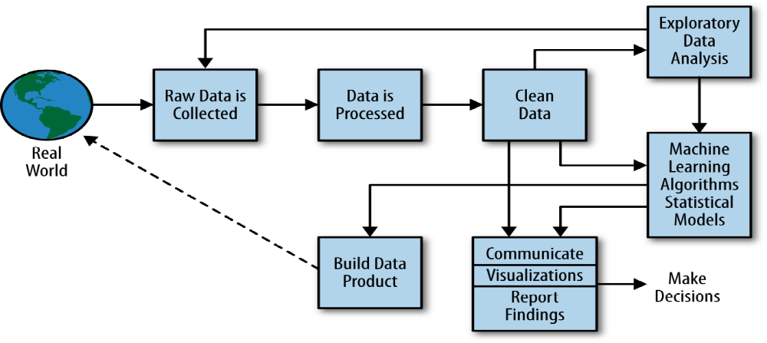
Data Science Process

Slide 8
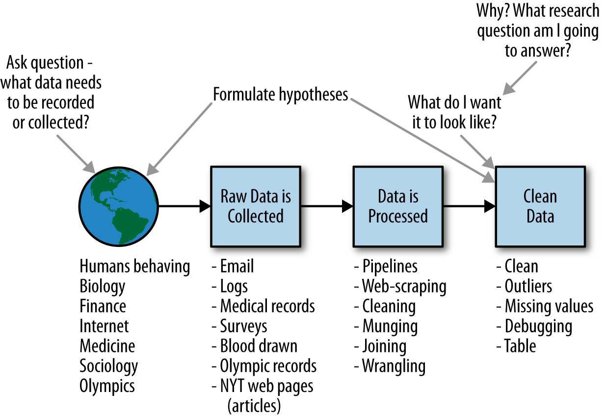
A Data Scientist’s Role in This Process

Slide 9
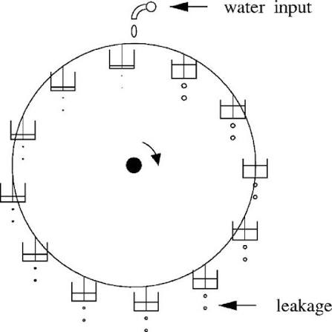
Thought Experiment: How Would You Simulate Chaos?

Slide 10
A Lorenzian water wheel, which is a Ferris wheel-type contraption with equally spaced buckets of water that rotate around in a circle. Now imagine water being dripped into the system at the very top. Each bucket has a leak, so some water escapes into whatever bucket is directly below the drip. Depending on the rate of the water coming in, this system exhibits a chaotic process that depends on molecular-level interactions of water molecules on the sides of the buckets.
Many systems can exhibit inherent chaos. Philippe M. Binder and Roderick V. Jensen have written a paper entitled “Simulating chaotic behavior with finite-state machines”, which is about digital computer simulations of chaos.
Humanitarian emergency simulation: Students simulate a crisis to learn how to create order and make decisions amid chaos.

Slide 11
Case Study: Real Direct
Goal: Use real estate data to improve the process of buying and selling homes.
Problem 1 – Broker system:
  Brokers usually work independently.
  Valuable knowledge is scattered among individual brokers.
  RealDirect brings licensed agents together to share knowledge.
Problem 2 – Outdated data:
  Public real estate data can have a 3-month delay.
  Decisions may therefore be based on old information.

Slide 12
How RealDirect Uses Data
Collects data from public and new information sources.
Tracks home searches and online behavior.
Looks at initial offers.
Tracks time between offer and closing.
Uses interaction data to provide real-time recommendations.
Gives sellers data-driven tips.

Slide 13
RealDirect as a Data-Driven Platform
Acts as a platform for buyers and sellers.
Tracks the user's current status:
  Active
  Offer made
  Offer rejected
  Showing
  In contract
The software suggests different actions based on the user's status.
This makes the process more organized and data-driven.

Slide 14
How Does RealDirect Make Money?
Seller subscription: About $395/month for access to selling tools.
Reduced commission: Sellers can use RealDirect agents at around 2% commission.
Traditional commission mentioned in the text: 2.5%–3%.
Data pooling helps RealDirect operate more efficiently.
Lower commission can be supported by handling more sales volume.

Slide 15
Challenges:
New York law requires registration to access all current listings.
Some traditional realtors disliked RealDirect's lower-commission approach.

Slide 16
Machine Learning Algorithms
Machine learning algorithms are largely used to:
Predict
Classify
Cluster
Statistical modeling and machine learning have some overlap.
Some methods, such as linear regression, are used in both statistics and machine learning.

Slide 17
Statistics and Machine Learning
Statistical Modeling
Focuses on understanding relationships
Interprets model parameters
Studies uncertainty
Makes explicit assumptions about data
Machine Learning
Often focuses on prediction and classification
Focuses on predictive accuracy
Many algorithms do not directly provide confidence intervals
Some methods make few or no distributional assumptions

Slide 18
Linear Regression
Linear regression is one of the most common statistical methods.
It is used to:
Express the mathematical relationship between variables
Predict numerical outcomes
Understand or describe relationships
It assumes a linear relationship between variables.

Slide 19
The basic linear model is:
Where:
y → outcome
x → predictor
β₀→ intercept
β₁→ slope
y = β₀ +β₁x

Slide 20
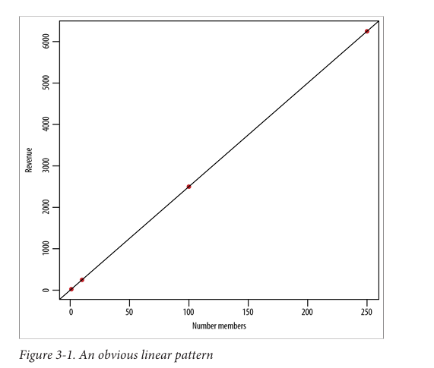
Example 1. Suppose you run a social networking site that charges a monthly subscription fee of $25, and that this is your only source of revenue. Each month you collect data and count your number of users and total revenue. You’ve done this daily over the course of two years, recording it all in a spreadsheet.
S= {(x, y) = (1,25) , (10,250) , (100,2500) ,(200,5000)}
• There’s a linear pattern.
• The coefficient relating x and y is 25.
• It seems deterministic.

Slide 21
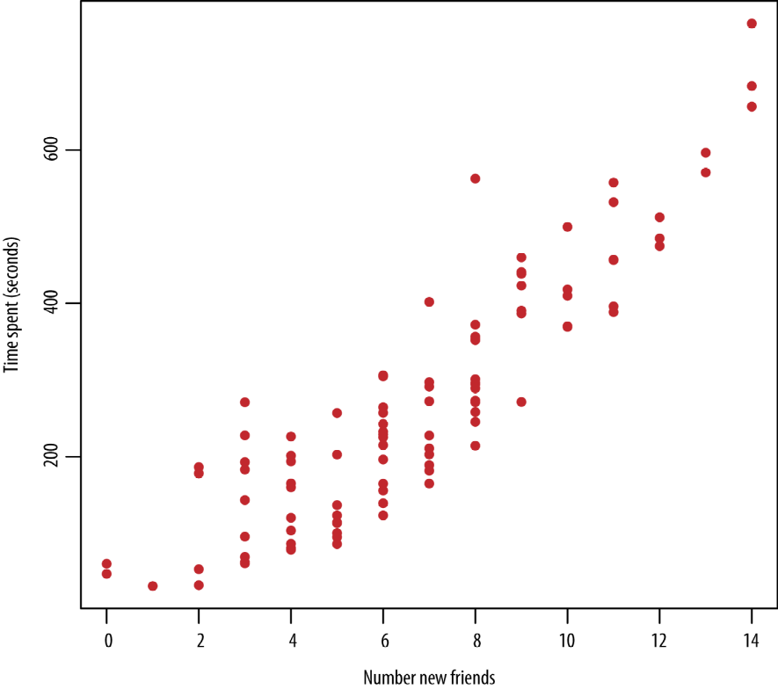
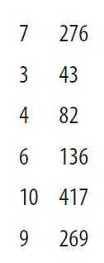
Example 2. Say you have a dataset keyed by user (meaning each row contains data for a single user), and the columns represent user behavior on a social networking site over a period of a week. Let’s say you feel comfortable that the data is clean at this stage and that you have on the order of hundreds of thousands of users. The names of the columns are total_num_friends, total_new_friends_this_week, num_visits, time_spent, num ber_apps_downloaded, number_ads_shown, gender, age, and so on.

Slide 22
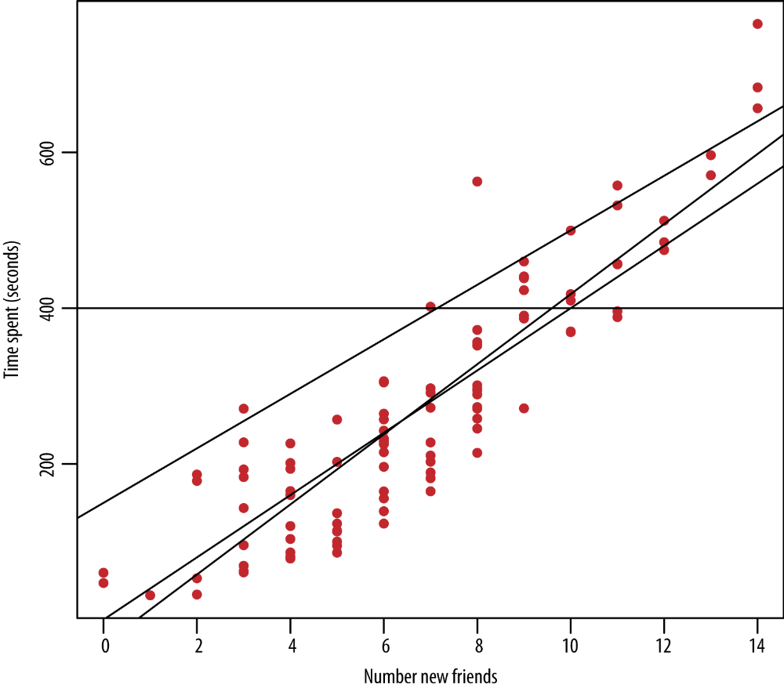

Slide 23
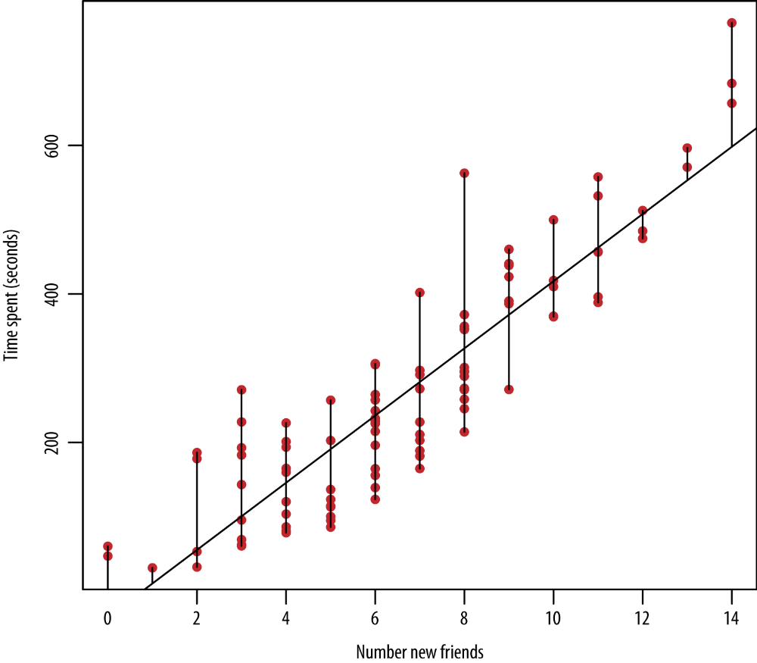

Slide 24

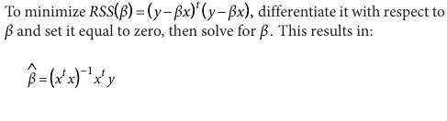
To find this line, you’ll define the “residual sum of squares” (RSS), denoted RSS (β) to be:

Slide 25

Obtain regression equation of Y on X and estimate Y when X=55 from the following

Slide 26
